Slide 1
Civil rights
“the nonpolitical rights of a citizen”

Slide 2
Training requirements
The United States Department of Agriculture (USDA) trains state agencies and Food Banks annually
Food Banks then train food pantries, staff, and volunteers who distribute federal foods.
Trainings are required and must occur once a year.
Training includes:
Assurances
Race and Ethnicity data collection
Effective public notification system
Discrimination complaint procedures
Compliance review techniques & resolving noncompliance
Requirements for reasonable modifications for persons with disabilities
Language access for neighbors with Limited English Proficiency
Customer service & conflict resolution

Slide 3
What is discrimination?
Different treatment which makes a distinction of one person or a group of persons from others’ either intentionally, by neglect, or by the actions or lack of actions
Protected classes are:
Race
Color
National Origin
Age
Disability
Sex (including gender identity & sexual orientation)

Slide 4
Elements of public notification
All Food Nutrition Service (FNS) assistance programs must include this to inform neighbors on:
Program availability
Program rights & responsibilities
Complaint information – at the distribution site, neighbors have the right to file a complaint, will be instructed how to file a complaint, and will be informed what the complaint procedures are.
Nondiscrimination statement – any print or digital materials using the verbiage USDA, TEFAP, CSFP, etc. must use the full statement
Examples:
Applications
Advertisements about the programs
Websites
Any notices of eligibility, ineligibility, or adverse actions (such as removal from programs)

Slide 5
Elements of Public Notification
Anyone distributing federal foods is required to:
Make program information available to neighbors upon request
Prominently display the “And Justice for All” poster
Inform neighbors of programs and any changes to programs
Have inclusive graphics and photos on program materials
Provide materials in other languages and in other formats for neighbors with disabilities
Assistance Tagline Translations | Food and Nutrition Service (usda.gov)
This Photo by Unknown Author is licensed under CC BY-SA

Slide 6
Nondiscrimination Statement
In accordance with federal civil rights law and U.S. Department of Agriculture (USDA) civil rights regulations and policies, this institution is prohibited from discriminating on the basis of race, color, national origin, sex (including gender identity and sexual orientation), disability, age, or reprisal or retaliation for prior civil rights activity. Program information may be made available in languages other than English. Persons with disabilities who require alternative means of communication to obtain program information (e.g., Braille, large print, audiotape, American Sign Language), should contact the responsible state or local agency that administers the program or USDA’s TARGET Center at (202) 720-2600 (voice and TTY) or contact USDA through the Federal Relay Service at (800) 877-8339.
To file a program discrimination complaint, a Complainant should complete a Form AD-3027, USDA Program Discrimination Complaint Form which can be obtained online at: https://www.usda.gov/sites/default/files/documents/USDA-OASCR%20P-Complaint-Form-0508-0002-508-11-28-17Fax2Mail.pdf, from any USDA office, by calling (866) 632-9992, or by writing a letter addressed to USDA. The letter must contain the complainant’s name, address, telephone number, and a written description of the alleged discriminatory action in sufficient detail to inform the Assistant Secretary for Civil Rights (ASCR) about the nature and date of an alleged civil rights violation. The completed AD-3027 form or letter must be submitted to USDA by:
1.mail:
U.S. Department of Agriculture
Office of the Assistant Secretary for Civil Rights
1400 Independence Avenue, SW
Washington, D.C. 20250-9410
2.fax: (833)256-1665 or (202) 690 7442
3. email: program.intake@usda.gov
The program standards are applied without discrimination by race, color, national origin, age, sex or disability.

Slide 7
Nondiscrimination statement
The short version:
“This institution is an equal opportunity provider.”
To use this version, it must be pre-approved and used in rare exceptions.
To find additional translations in 22 non-English languages, go to:
Nondiscrimination Statement | Food and Nutrition Service (usda.gov)
The Nondiscrimination Statement is on the “And Justice for All” poster in both English and Spanish. This must be displayed at the distribution sites.
Additional translations at this link And Justice for All Posters (Guidance and Translations) | Food and Nutrition Service (usda.gov)
The 2022 Nondiscrimination Statement has not been printed on posters yet. Continue using the poster with the 2019 copyright.

Slide 8
Csfp: Collecting racial & ethnic data
CSFP is a federal program geared towards extremely low-income seniors 60+.
Sites that serve these foods must collect racial and ethnic data on the application.
This applications are stored with the distribution site’s files for 4 years.
The federal government uses this information to evaluate how effectively the program is reaching different populations.
The data shows if Food Banks are reaching the different races and ethnicities in their service area.
Limited personnel will have access to these files.
If the applicant does not self-identify, staff or volunteers involved with the intake process will obtain the data using other appropriate methods. Let the client know.
This information is used only for statistical purposes, and it does not affect a senior’s eligibility.

Slide 9
Limited English Proficiency Persons (LEPs)
Individuals who do not speak English as their primary language and who have a limited ability to read, speak, write, or understand English because of their national origin.

Slide 10
LEPs
Title VI of the Civil Rights Act of 1964 and its implementing regulations,
Prohibit discrimination on the basis of race, color, or national origin
Must take reasonable steps to ensure “meaningful” access to their programs and activities by Limited English Proficient (LEP) persons.
Meaningful access is providing competent, accurate, timely, and effective language services at no cost to the LEP individual.
Failure to provide this could be discrimination on the basis of national origin.
For LEP individuals, meaningful access denotes access that is not significantly restricted, delayed, or inferior as compared to programs or activities provided to English proficient individuals.
Be mindful of:
The number or proportion of LEPs in your area
The frequency you come into contact with LEPS
The nature and importance of federal food programs
What resources are available and their costs
This Photo by Unknown Author is licensed under CC BY-SA

Slide 11
Top languages spoken besides English
Spanish
Tagalog
**Data pulled from LEP.gov, Census.gov, and State Immigration Statistics | OHSS - Office of Homeland Security Statistics (dhs.gov)
This Photo by Unknown Author is licensed under CC BY-ND

Slide 12
LEP Program access
What’s required:
Translations of documents in most common languages
Oral translation services
Qualified competent language resources
Training staff and volunteers how to help LEP neighbors
What’s approved:
An approved staff or volunteer who has been certified as competent in another language or is their native language
“I Speak” cards
Pocketalk or other devices approved by VDACS
**USDA does not recognize Google Translate or phone apps as accurate, competent, effective, and timely language services.
Continue to use until you can procure other resources or until the Foodbank can get funding to assist with this.
The tonight show ( Camila cabello ) Google translate songs (youtube.com)
Rules:
LEPs cannot be asked to bring their own interpreters.
Children should not be used as interpreters. Try using other resources first.
This Photo by Unknown Author is licensed under CC BY-SA

Slide 13
Additional LEP data
If you wish to learn more about LEP demographics in your area, please check out the following sites:
Department of Justice site: LEP.GOV
http://www.lep.gov/maps/
US Census Data
Data (census.gov)
American Community Survey
http://www.census.gov/acs/
Migration Policy Institute’s National Center on Immigrant Integration Policy
http://www.migrationpolicy.org/

Slide 14
Disability discrimination
A person who has a physical or mental impairment which substantially limits one or more major life activities, has a record of such an impairment, or is regarded as having such an impairment.
Major life activities impacted: caring for oneself, performing manual tasks, walking, seeing, hearing, speaking, breathing, learning, and working.
Functions impacted: immune system, normal cell growth, digestive, bowel, bladder, neurological, brain, respiratory, circulatory, cardiovascular, endocrine, and reproductive functions.

Slide 15
Laws specificly about disability discrimination
Make reasonable modifications in policies, practices, or procedures when the modifications are necessary to avoid discrimination on the basis of disability
Ensure communication is as effective for neighbors with hearing, visual, or speech disabilities as with others.
The ADA has similar nondiscrimination requirements that prohibit discrimination on the basis of disability in services, programs, and activities provided by State and local government entities.
Provide the most integrated setting where neighbors with disabilities have the opportunity to fully interact with individuals without disabilities.
This Photo by Unknown Author is licensed under CC BY-NC-ND

Slide 16
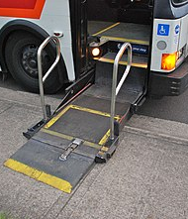
Reasonable accomodations
Obligated to provide neighbors modifications to make the programs accessible.
Examples are:
Braille
Large print
Audio tape
Qualified sign language interpreters
Other auxiliary aids
Websites and online applications need to be readily accessible and useable by persons with visual impairment & other disabilities.
The Foodbank of Southeastern Virginia and the Eastern Shore has both CSFP & TEFAP applications on our website.
Ensure facilities are physically accessible for neighbors who rely on service animals, wheelchairs, mobility aids, and other power-driven mobility devices.
You must permit service animals to go in all of the same areas that neighbors with disabilities can go.
This Photo by Unknown Author is licensed under CC BY-SA

Slide 17
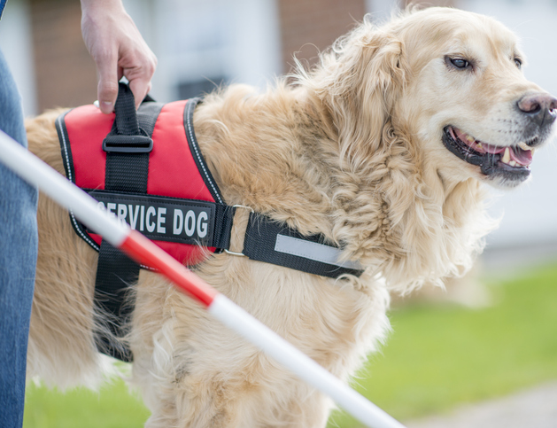
Service Animals
The ADA says on their site https://www.ada.gov/topics/service-animals/ the following:
Service animals are:
Dogs
Any breed and any size of dog
Trained to perform a task directly related to a person’s disability
Are not required to wear vests, a dog that is wearing a vest is not necessarily a service animal. The dog still needs to be trained to perform a task for a person with a disability to be a service animal.
Service animals are not:
Required to be certified or go through a professional training program
Required to wear a vest or other ID that indicates they’re a service dog
Emotional support or comfort dogs, because providing emotional support or comfort is not a task related to a person’s disability
You may ask:
Is the dog a service animal required because of a disability?
What work or task has the dog been trained to perform?
You are not allowed to:
Request any documentation that the dog is registered, licensed, or certified as a service animal.
Require that the dog demonstrate its task, or inquire about the nature of the person’s disability
This Photo by Unknown Author is licensed under CC BY-ND

Slide 18
Equal Opportunity for religious organizations
7 CFR Part 16
Faith-based organizations and other community organizations can participate in USDA food programs.
Organizations must not discriminate on the basis of religion, religious belief, a refusal to hold a religious belief, or a refusal to attend or participate in a religious practice.
Organizations may not engage in explicitly religious activities as part of TEFAP or CSFP. This includes activities that involve overt religious content, such as worship, religious instruction, or proselytization.
The organization must separate in time or location any privately funded explicitly religious activities from activities supported with USDA direct assistance;
If neighbors object to the religious character of an organization, that organization must make reasonable efforts to identify and refer clients to an alternate food pantry. Refer neighbors to the Foodbank’s website: foodbankonline.org
This Photo by Unknown Author is licensed under CC BY-SA-NC

Slide 19
Written Beneficiary Notice
What the policy says:
1. We may not discriminate against you on the basis of religion, a religious belief, a refusal to hold a religious belief, or a refusal to attend or participate in a religious practice;
2. We may not require you to attend or participate in any explicitly religious activities (including activities that involve overt religious content such as worship, religious instruction, or proselytization) that are offered by our organization, and any participation by you in such activities must be purely voluntary;
3. We must separate in time or location any privately funded explicitly religious activities (including activities that involve overt religious content such as worship, religious instruction, or proselytization) from activities supported with direct Federal financial assistance.
Provides an option where to file a complaint and a hotline / text line to get food assistance elsewhere.
Where it goes:
Must be made available when applying and/or clearly posted for neighbors to see.
It is put in both CSFP and TEFAP boxes.

Slide 20
Customer service 12 Essential Customer Service Skills In 2024 – Forbes Advisor
1. Active Listening - Listening sounds like a simple thing to do, but active listening requires a great deal of focus and concentration. When engaging in active listening, customer service team members need to be attentive, patient and nonjudgmental for customers to feel that their issues are truly being heard.
2. Empathy - Empathy pairs with active listening because it means the customer service agent is hearing what the customer is saying without any preconceived notions or judgments. It focuses on recognizing, managing and responding to the emotions of customers as well as keeping your own emotions in check.
3. Problem Solving - When customers reach out with an issue, their expectation is usually that the customer service team will help them solve the problem. It’s crucial that businesses have efficient problem-solving systems in place to help customers as quickly and effectively as possible.
4. Conflict Resolution - Conflicts are stressful and stress can lead to short tempers, irrational actions and difficulty thinking clearly. You don’t want your customers to feel stressed, so managing and resolving conflicts as soon as possible is a critical part of good customer service.
5. Organization - Being able to access both information and support quickly ensures that customer service agents will be able to assist customers confidently.
6. Good Memory - An already-annoyed customer who contacts customer service with an issue is guaranteed to get angrier and angrier the more they are asked to repeat themselves. Having a good memory is a customer service skill that will inevitably lead to a smoother dialogue, resulting in customers who feel less stressed and more taken care of.
7. Adaptability - Adaptability in customer service means approaching a situation without expectations and knowing when it is time to switch directions to offer the most effective help.
8. Time Management - Customers want to receive prompt responses, and the only way for that to happen is when customer service teams are cognizant of their time management..
9. Knowledge - The quality of your customer service will rely heavily on team members’ knowledge about products and services. They need to know enough to answer questions, troubleshoot technical challenges and offer suggestions.
10. Communication - Whether in person, over the phone or electronically, communication is the cornerstone of customer service. Communicating effectively means taking the time to not only talk but also to listen.
11. Transparency - Customers want their issues resolved, but they are also often interested in knowing how or why a problem may have occurred in the first place. Transparency in customer service doesn’t mean sharing all the trade secrets. Rather, it’s about being upfront and honest when helping to solve problems. Honesty goes a long way in building and maintaining positive customer relationships, even when it means admitting mistakes.
12. Humor - Unhappy customers are not funny and should never be treated like a joke. But when used correctly in certain situations, humor can be a powerful skill to help lighten the mood and diffuse tension. After figuring out what a customer is seeking and why they are frustrated, a well-timed funny comment is often exactly what is needed to help put the customer at ease and adjust their attitude.

Slide 21
Conflict resolution
Identify the Problem
Based on the information the client gave you
Determine a Solution
Depending on the specifics, the solution may involve calling the client again
Gain Approval from the Client
If the client doesn’t agree to the proposed solution, it will solve nothing.
Make an Agreement
You and the client should determine what, when, by whom it will be done.
Follow Up
Make sure that the client is satisfied and provide feedback.

Slide 22
Be mindful of
Cultural considerations you should keep in mind when interacting with neighbors:
They might have been forced to leave their own culture.
They might be adopting a new culture.
They might have experienced discrimination in past.
They might be experiencing trauma which can “interfere with their daily life and ability to function and interact with others.”
Tips to navigate neighbors who are presenting mental health challenges:
Approach, assess for risk of suicide or harm, and assist
Listen nonjudgmentally
Give reassurance and information
Encourage appropriate professional help
Encourage self-help and other support strategies

Slide 23
Complaints of Discrimination
Complaints must be filed within 180 days from the alleged act of discrimination, with exceptions.
Only the Secretary of Agriculture can extend the time period beyond 180 days.
Complaints may be written, verbal, or anonymous.
Forward complaints based on race, color, national origin, sex (including gender identity and sexual orientation), and disability to CRD within five (5) calendar days of receipt.
Forward complaints based on age (or a combination of age and other bases to CRD within five (5) business days of receipt.
You can use the complaint form that the Foodbank provides, but neighbors aren’t required to use that form for the complaint to be accepted.

Slide 24
Complaint Requirements
Try to collect all of the following information to submit to the Foodbank and to USDA:
Name, address, and telephone number of the complainant
The location and name of the organization or office
The nature of the incident or action
The names, titles, and business addresses of persons who may have knowledge of the discriminatory action
The date(s) during which the alleged discriminatory actions occurred
The basis for the alleged discrimination
Send information to the Foodbank via email, and send the information to USDA by one of the following methods:
Mail: U.S. Department of Agriculture
Director, Center for Civil Rights Enforcement
1400 Independence Avenue, SW
Washington, DC 20250-9410
Fax: (202) 690-7442
email: program.intake@usda.gov
The State and the Foodbank maintain a log of Civil Rights complaints.
Confidentiality is extremely important and must be maintained.

Slide 25
Compliance reviews
These are to determine Civil Rights compliance.
The Food Nutrition Service (FNS) Civil Rights and Program staff review state agencies → state agencies review Food Banks → Food Banks review the food pantries who work with them
Any significant findings will be provided in writing the to the site being reviewed and to FNS.

Slide 26
Compliance reviews
Pre-Award Compliance Review
This is prior to serving. The State wants to evaluate what things do pantries have in place to avoid discrimination. The State uses this to along with an inspection form to approve pantries to serve and to store federal foods.
Routine / Post Award Compliance Review
Are staff/volunteers discriminating neighbors on any of the protected classes?
Do printed materials contain the full Nondiscrimination Statement?
Is the “And Justice For All” poster displayed?
Are the complaint forms available to neighbors?
Is program information available to all?
Are religious organizations requiring or implying a need to participate in religious activities to get food?
This may or may not be scheduled in advance. The federal government, the state, and the Foodbank reserve the right to stop by during any distribution without prior notice.
Special Compliance Review
This is to follow-up on discrimination complaints and to investigate if there’s any evidence to support the complaint.
Is there a history of statistical underrepresentation of particular group(s)?
This may or may not be scheduled in advance. The federal government, the state, and the Foodbank reserve the right to stop by during any distribution without prior notice.
Assure to operate the program in compliance with all of the nondiscrimination laws, regulations, instructions, policies, and guidelines.

Slide 27
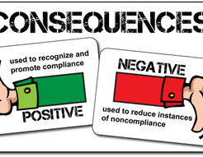
What happens if you’re not compliant?
If a site is not compliant and there are factual findings to support the complaint, the Foodbank will work with that site to get them back into compliance immediately.
The agency will enter into a resolution agreement with the Foodbank, the state, and USDA.
A finding’s effective date is the date of notice to the reviewed site.
If a site continues to be noncompliant after the Foodbank provided guidance, both the TEFAP and CSFP food programs allow the Foodbank to terminate access to those food programs by giving a 30-day notice in writing.
This Photo by Unknown Author is licensed under CC BY-NC-ND

Slide 28
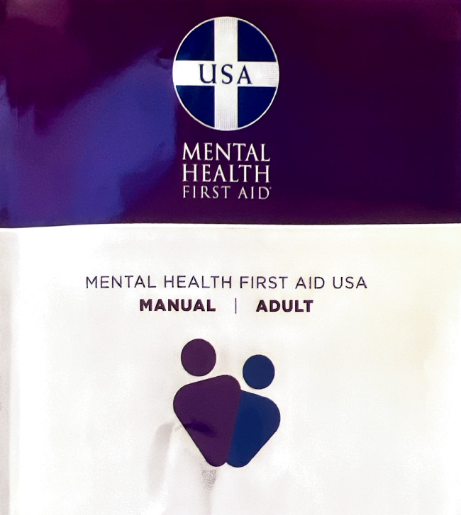
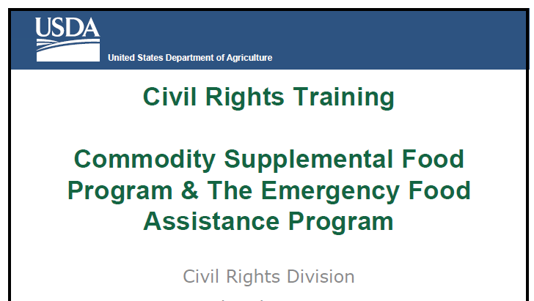
Sources
https://www.ada.gov/topics/service-animals/
Civil Rights | Food and Nutrition Service (usda.gov)
12 Essential Customer Service Skills In 2024 – Forbes Advisor

